Slide 1
Unit 3~ Unit 4
Review 2

Slide 2
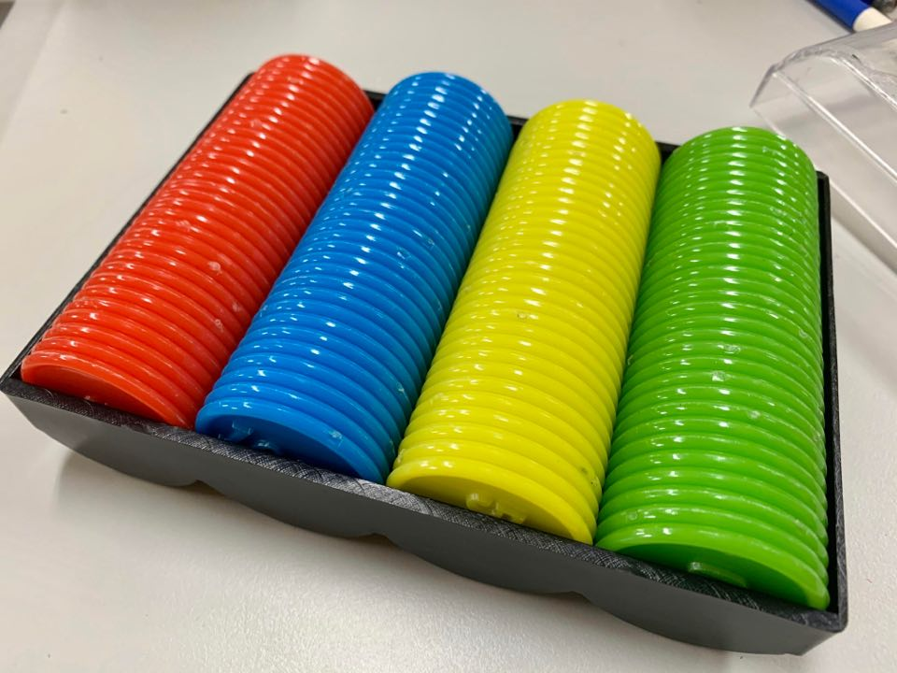
Get your CHIPS ready…
One chip for each color!

Slide 3
Question 1.
a a_e o o_e
請依序排出聽到的音組:

Slide 4
Question 2.
i i_e e ee
請依序排出聽到的音組:

Slide 5
Question 3.
duck duke buck buke
The ____ eats a _____.

Slide 6
Question 4.
kit ket hike hat
Let’s go _____ with a _____ and a _____.

Slide 7
Question 5.
cod Peet tub bath
_____ has a _____ , and he wants to take a _____ in the _____.

Slide 8
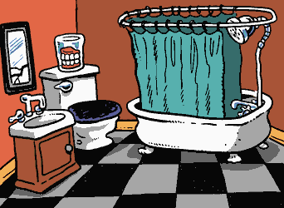
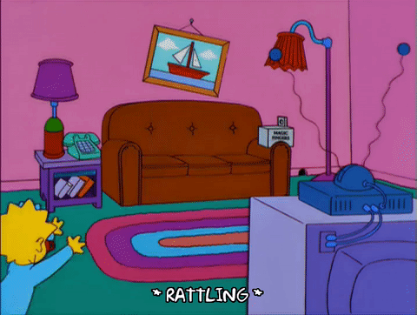
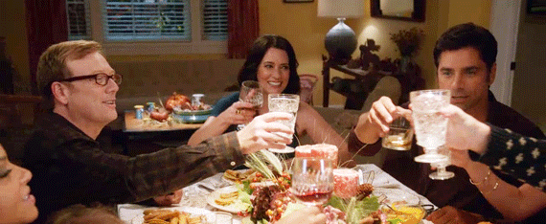
Question 6.
請仔細聽單字出現順序!

Slide 9
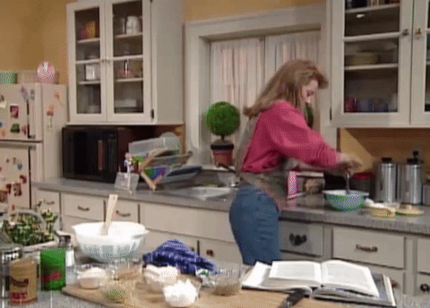
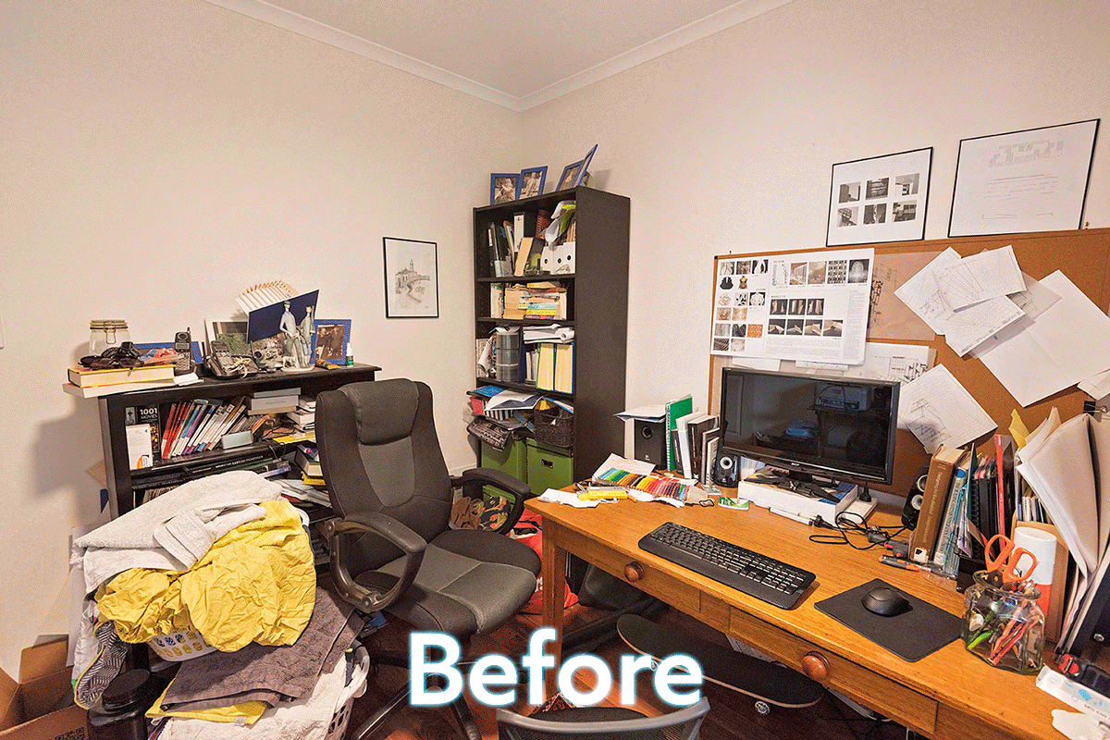
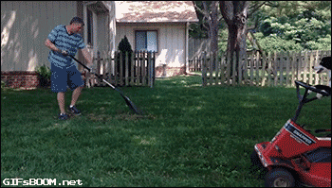
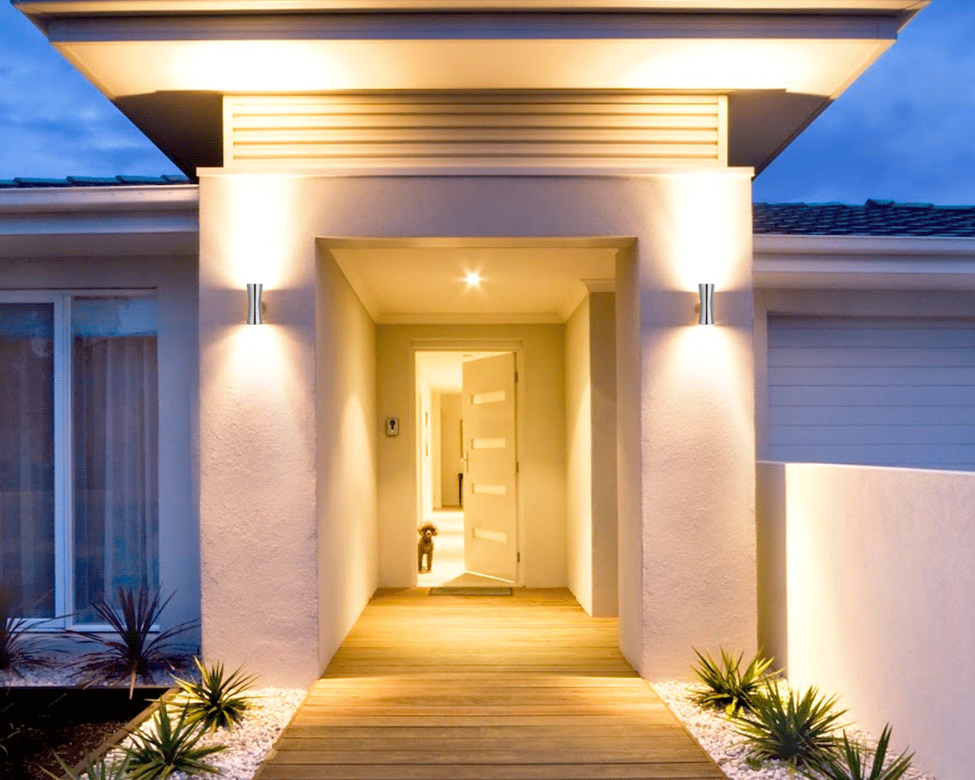
Question 7.
請仔細聽單字出現順序!

Slide 10
Question 8.
I You He We
哪個主詞後面接的be動詞為are

Slide 11
Question 9.
Where Mandy is ?
排出正確句子!

Slide 12
Question 10.
singing I’m in the bathroom.
排出正確句子!

Slide 13
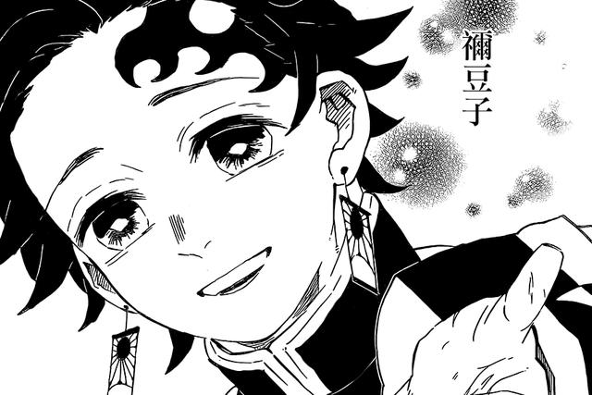
Question 11.
Where What look looking
_____ are you doing?
I’m _____ for my sister.

Slide 14
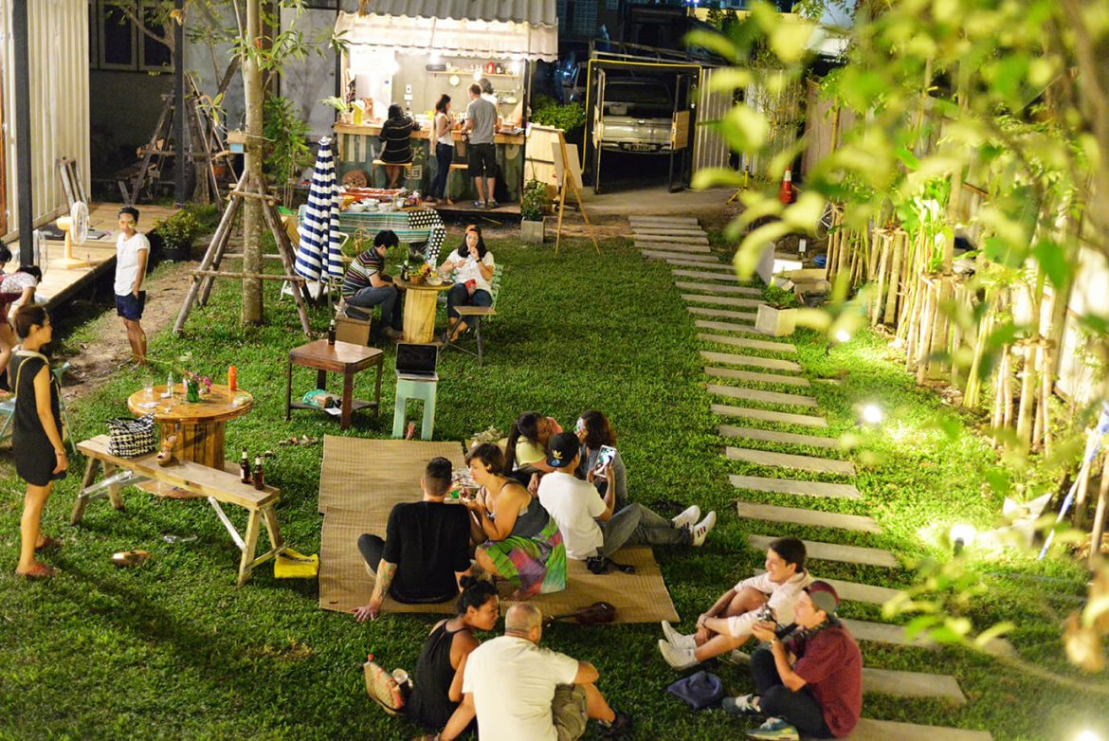
Question 12.
Where What study yard
____ are they?
They’re in the _____.

Slide 15
Question 13.
按照圖片的順序由左向右排單字
in on under next to

Slide 16
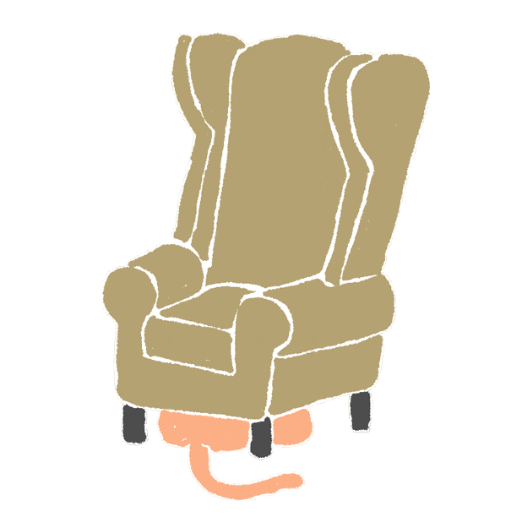
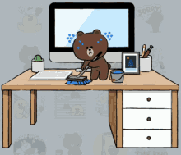
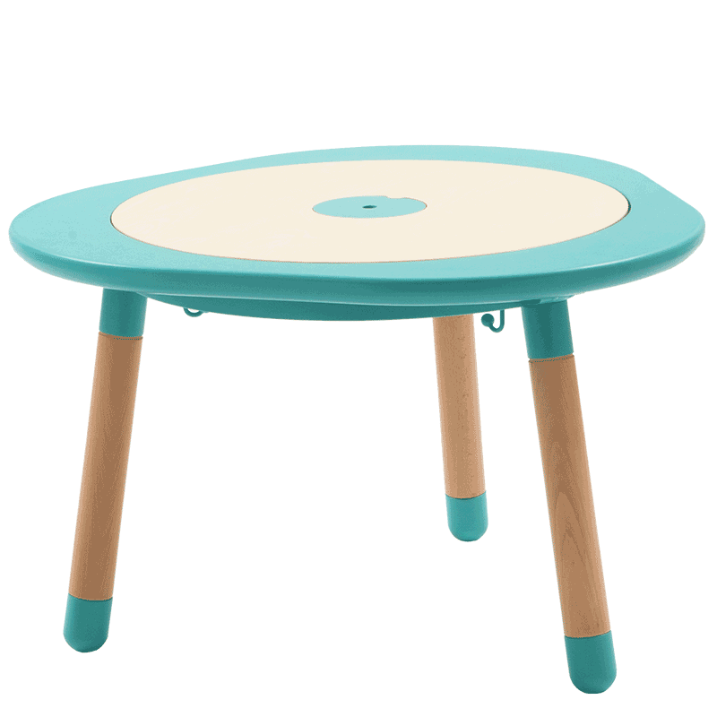
Question 14.
按照圖片的順序由左向右排單字
table chair bag desk

Slide 17
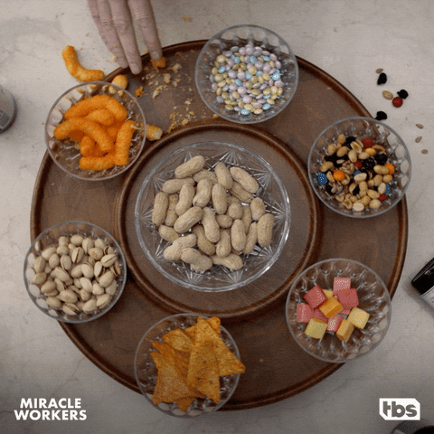
Question 15.
What’s this?
desk lazy Susan round table pretty Mandy

Slide 18
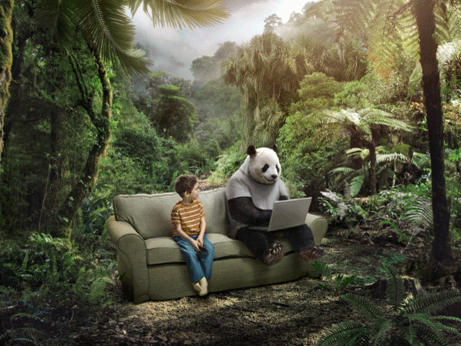
Question 16.
They’re sitting ___ the sofa.
in on under next to

Slide 19
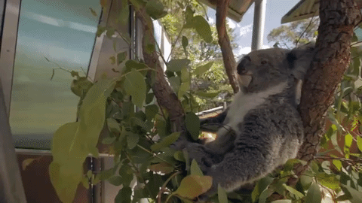
Question 17.
The koala is ___ the tree.
in on under next to

Slide 20
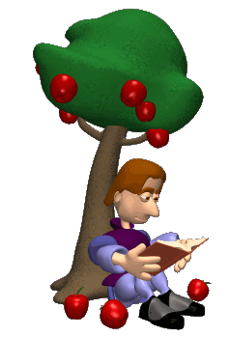
Question 18.
Newton is ___ the apple tree.
in on under next to

Slide 21
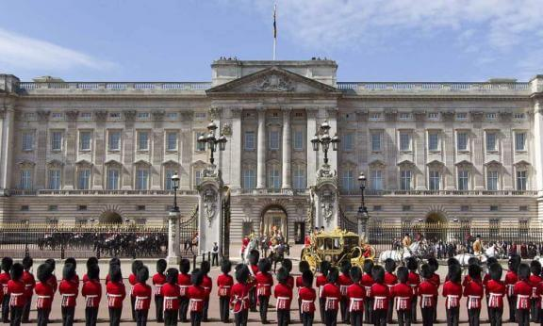
Question 19.
Where is it?
Buckingham White the UK the USA
Palace House

Slide 22
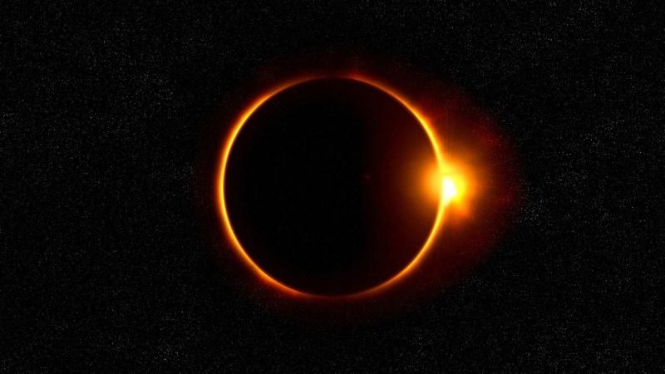
Question 20.
日環食的英文是…
dog solar annual circle
eating energy solar sun
sun eclipse shadow

Slide 23
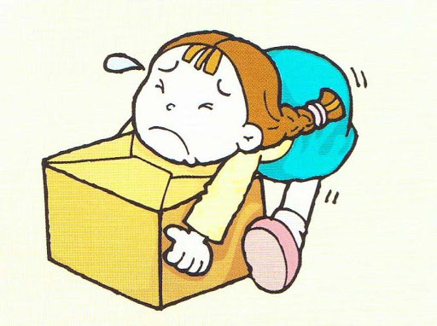
Question 21.
有哪些說法可以表達「你可以幫助我嗎?」

Slide 24
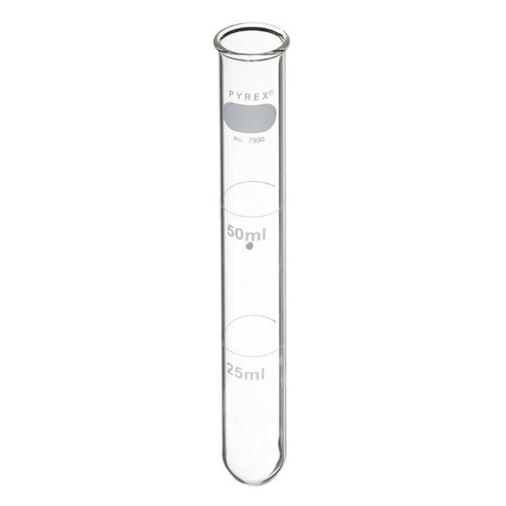
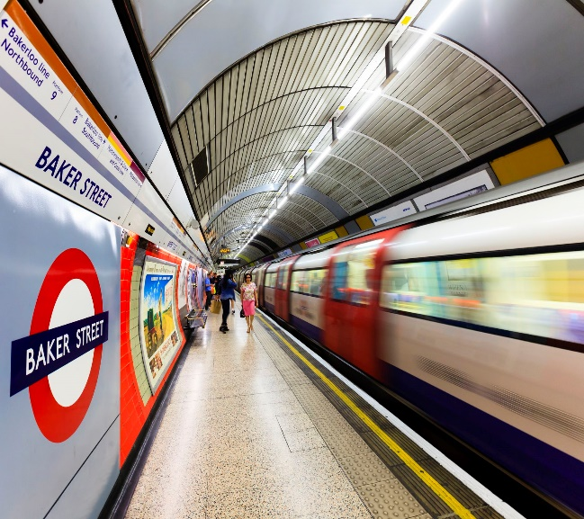
Question 22.
下列哪些與tube有關

Slide 25
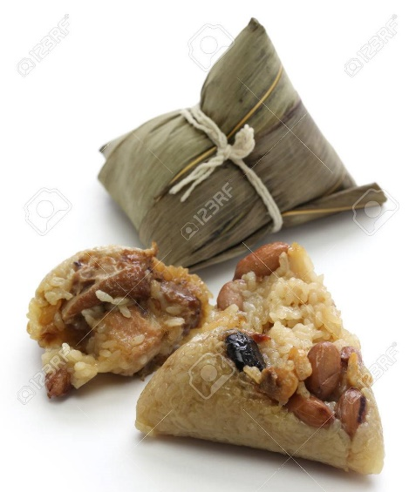
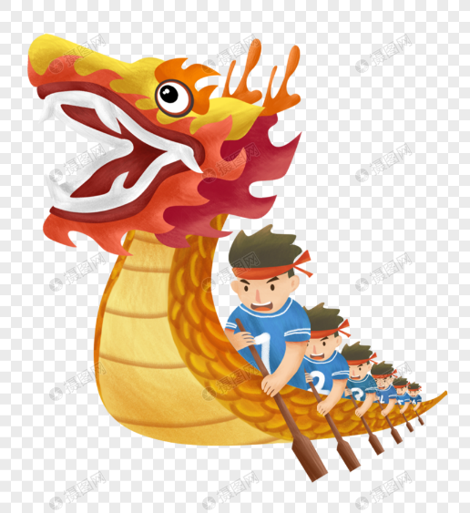
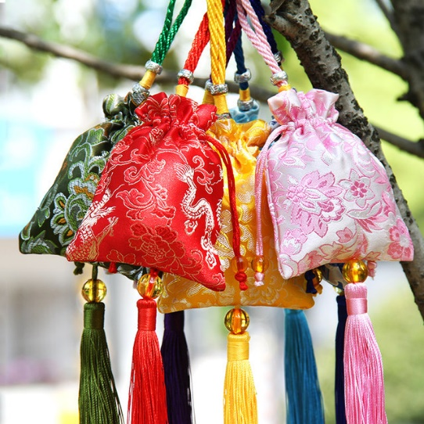
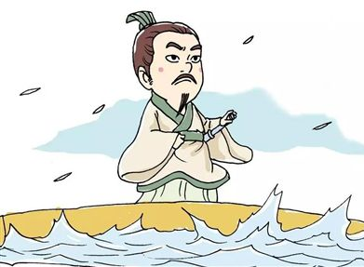
Question 23.
下列哪些與Dragon Boat Festival有關

